Slide 1
Iteration 1
Team 5
Team Members: Abbinav H. Burhanuddin C. Dhairya C. Ritesh M.
CSE 6324-001

Slide 2

Agenda
Project Plan
Specification and Design
Code and Tests
Customers and Users
References
Q&A
[2]

Slide 3

Project Plan
[5]
Features Plan
Understand Gas Gauge and Manticore Tools’ Functionality.
Have Gas Gauge and Manticore Tools’ Compile and Running.
Use Available Smart Contracts as Input for Gas Gauge and Manticore Tools’.

Slide 4
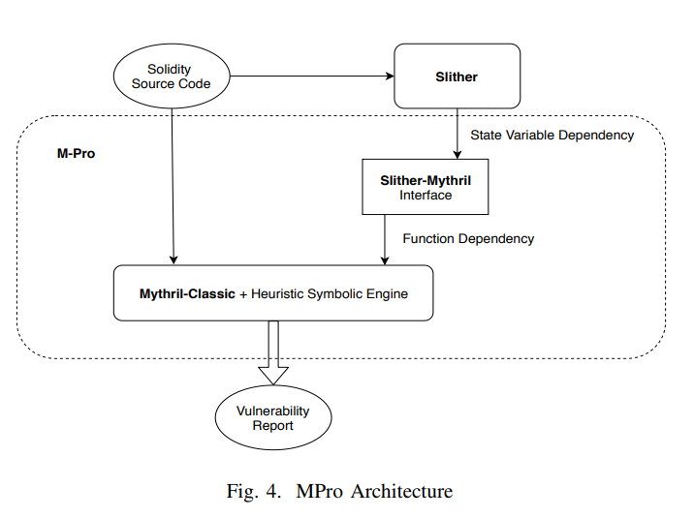
Project Plan
Apps Differences
MPro: Incorporates Static Analysis and Symbolic Execution. [1]
GasCore+: Incorporate Static Analysis, Dynamic Analysis and Symbolic Execution from Gas Gauge and Manticore.
[1]
[1]

Slide 5
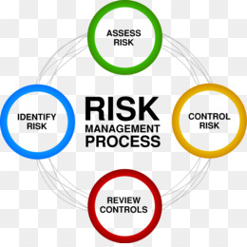
Project Plan
Top 5 Risks
Risk 1: No Extra Documentation for Gas Gauge and Manticore.
Risk 2: Gas Gauge running on Windows/Linux OS and Manticore running on Linux OS.
Risk 3: Finding Available/Compatible Smart Contracts.
Risk 4: Availability of Linux OS Device.
Risk 5: Team Member Scheduling Issues.
[3]

Slide 6

Specification and Design
Features Implemented
Windows Support for GasGauge
Modified Linux Commands and utilized Windows libraries.
Future Features
Manticore-Verify
User Contracts
Stop Conditions
[6]

Slide 7
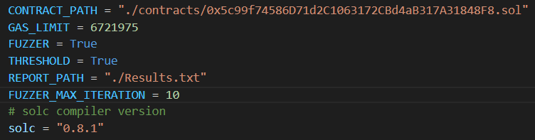
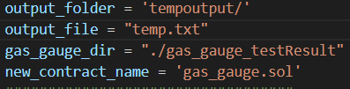
Specification and Design
Input
Output

Slide 8
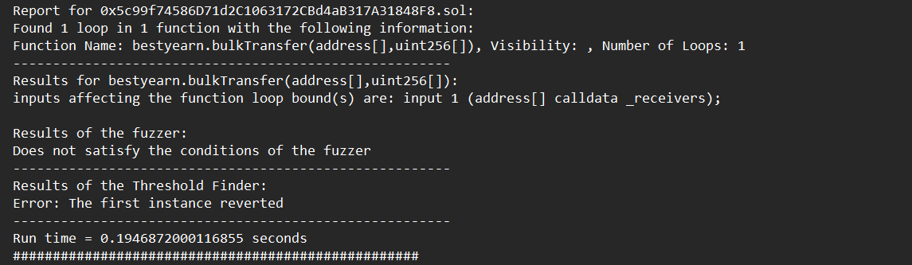
Code and Tests
Changes:
Modifying Linux Libraries.
Modifying imports.
Modifying Linux commands to Windows.
Adding additional logic to help with Windows implementation.
Repository - https://github.com/Abbinav/CSE-6324-Team5/tree/master

Slide 9
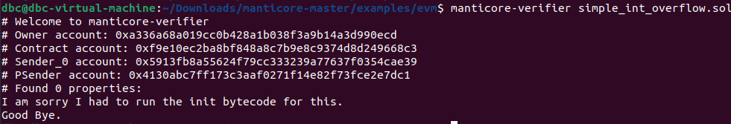
Code and Tests
Changes:
Changes to simple_int_overflow.sol(Smart Contract)
Changes to solc.py
Changes to types.py

Slide 10

Customer and Users
[4]
Reach out to Shovon for available Smart Contracts
Provided Team with Smart Contract Github Links.
Reached out to Shovon for validation of Gas Gauge results
Shovon will look into Gas Gauge.
Reached out to Manticore’s Slack Channel for Assistance/Feedback
Currently waiting for response from Manticore Team Members.

Slide 11
References
[1] W. Zhang, S. Banescu, L. Pasos, S. Stewart and V. Ganesh, "MPro: Combining Static and Symbolic Analysis for Scalable Testing of Smart Contract," in 2019 [2]https://www.vectorstock.com/royalty-free-vector/agenda-list-concept-vector-13201810, Accessed 9/2022
[3] Risk Management Plan PNG and Risk Management Plan Transparent Clipart Free Download. - CleanPNG / KissPNG, Accessed 09/2022
[4]Computer Icons Customer Service Users' Group PNG, Clipart, Black, Black And White, Business, Circle, Company Free PNG Download (imgbin.com), Accessed 9/2022
[5]https://twproject.com/blog/choose-project-management-software-mother-tongue, Accessed 9/2022
[6]Linux vs. Windows: What's the difference in 2022? | Linux Journal, Accessed 9/2022
[7]https://github.com/gasgauge/gasgauge.github.io, Accessed 9/2022

Slide 12
Thank you
Questions?

